Slide 1

IDENTIFICATION OF EVENT IN HUMAN OBJECT

Slide 2
ACKNOWLEDGEMENT
We would like to express our special thanks of gratitude to our teacher Dr. Anup Kolya as well as our principal Prof. (Dr.) Arup Kumar Bhaumik who gave us the golden opportunity to do this wonderful project on the topic Identification of event in human object, which also helped us in doing a lot of Research and we came to know about so many new things we are really thankful to them.
Secondly, We would also like to thank our friends who helped us a lot.

Slide 3
INDEX
Dense Captioning
A pretrained model
Running the model on new images
Training new DenseCap model
Event Extraction
Examples

Slide 4
DENSE CAPTIONING
Addressing the problem of dense captioning means a computer detects objects in images and describes them in natural language.

Slide 5
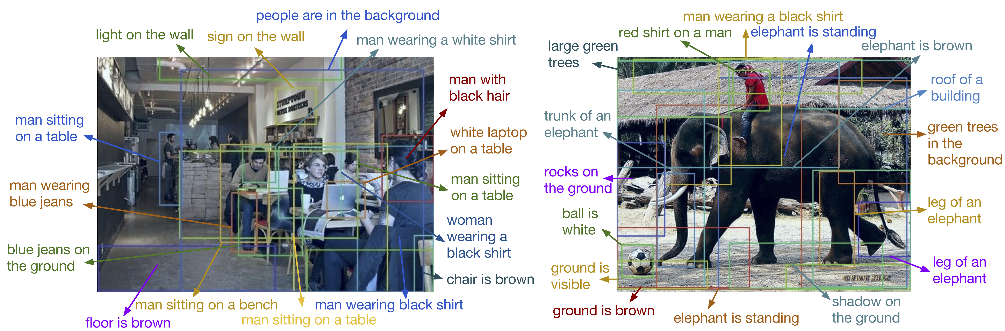
example of densecap

Slide 6
PRETRAINED MODEL
Step 1: Downloading pretrained model
sh scripts/download_pretrained_model.sh
unziped version will be of size 1.2GB.

Slide 7
RUNNING ON PRETRAINED MODEL
Step 2: Running the model on new image.
th run_model.lua -input_image imgs/elephant.jpg
this will run the model on provided elephant.jpg image.

Slide 8
TRAINING NEW DENSECAP MODEL
Step 3: Download the raw images and region descriptions from the Visual Genome website
Use the script preprocess.py to generate a single HDF5 file containing the entire dataset
Use the script train.lua to train the model
Use the script evaluate_model.lua to evaluate a trained model on the validation or test data

Slide 9
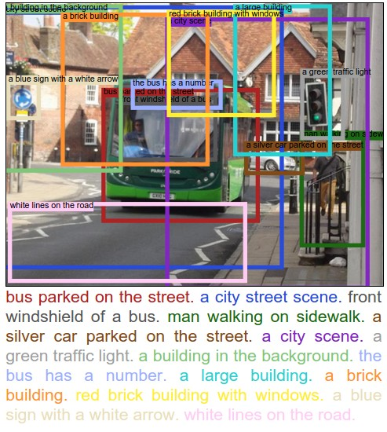
Output...

Slide 10
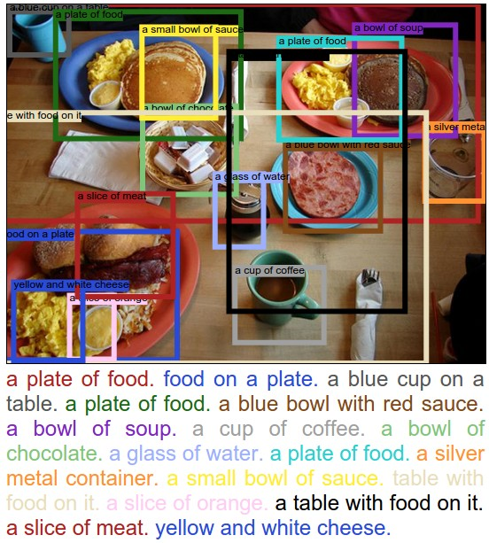
Output...

Slide 11
Event Extraction
The output of DenseCap model is given as input to the Stanford CoreNLP parser. From this region mapping input, parser identifies the verbs to detect event in object. We are using an offline version of this parser which is mostly program, coded using java language.
For linux system command is:
./stanford-postagger-gui.sh

Slide 12
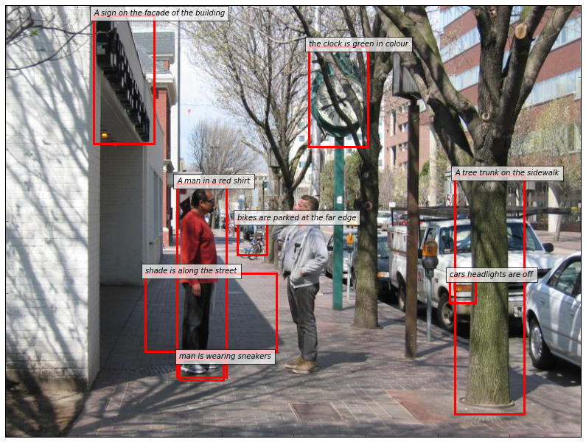
dense Captioning:input to parser
A sign on the facade of building, the clock is green in colour, a man in a red shirt, bikes are parked at the far edge, shade ins along the street, man is wearing sneakers, a tree trunk on the sidewalk, cars headlights are off

Slide 13
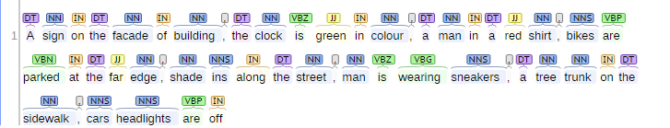
output from parser
Extracted Events are:: parked, wearing

Slide 14
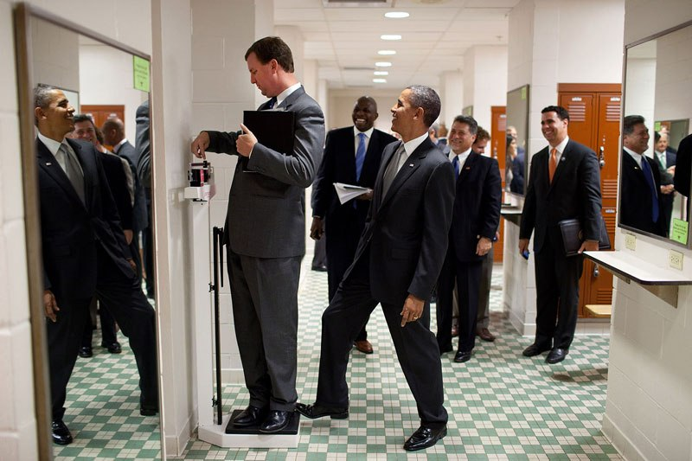
What's the story behind this picture...?

Slide 15
Future work & Conclusion
After a long search through many published paper to understand the process of extraction of an event from the input image, we have come across the densecap model for the image to natural language text output and by using Stanford CoreNLP parser, we have extracted events from natural language. Visual Genome has provided huge dataset, region description and image metadata that can be used to train this model and which can result in great improvement in accuracy of event extraction.

Slide 16
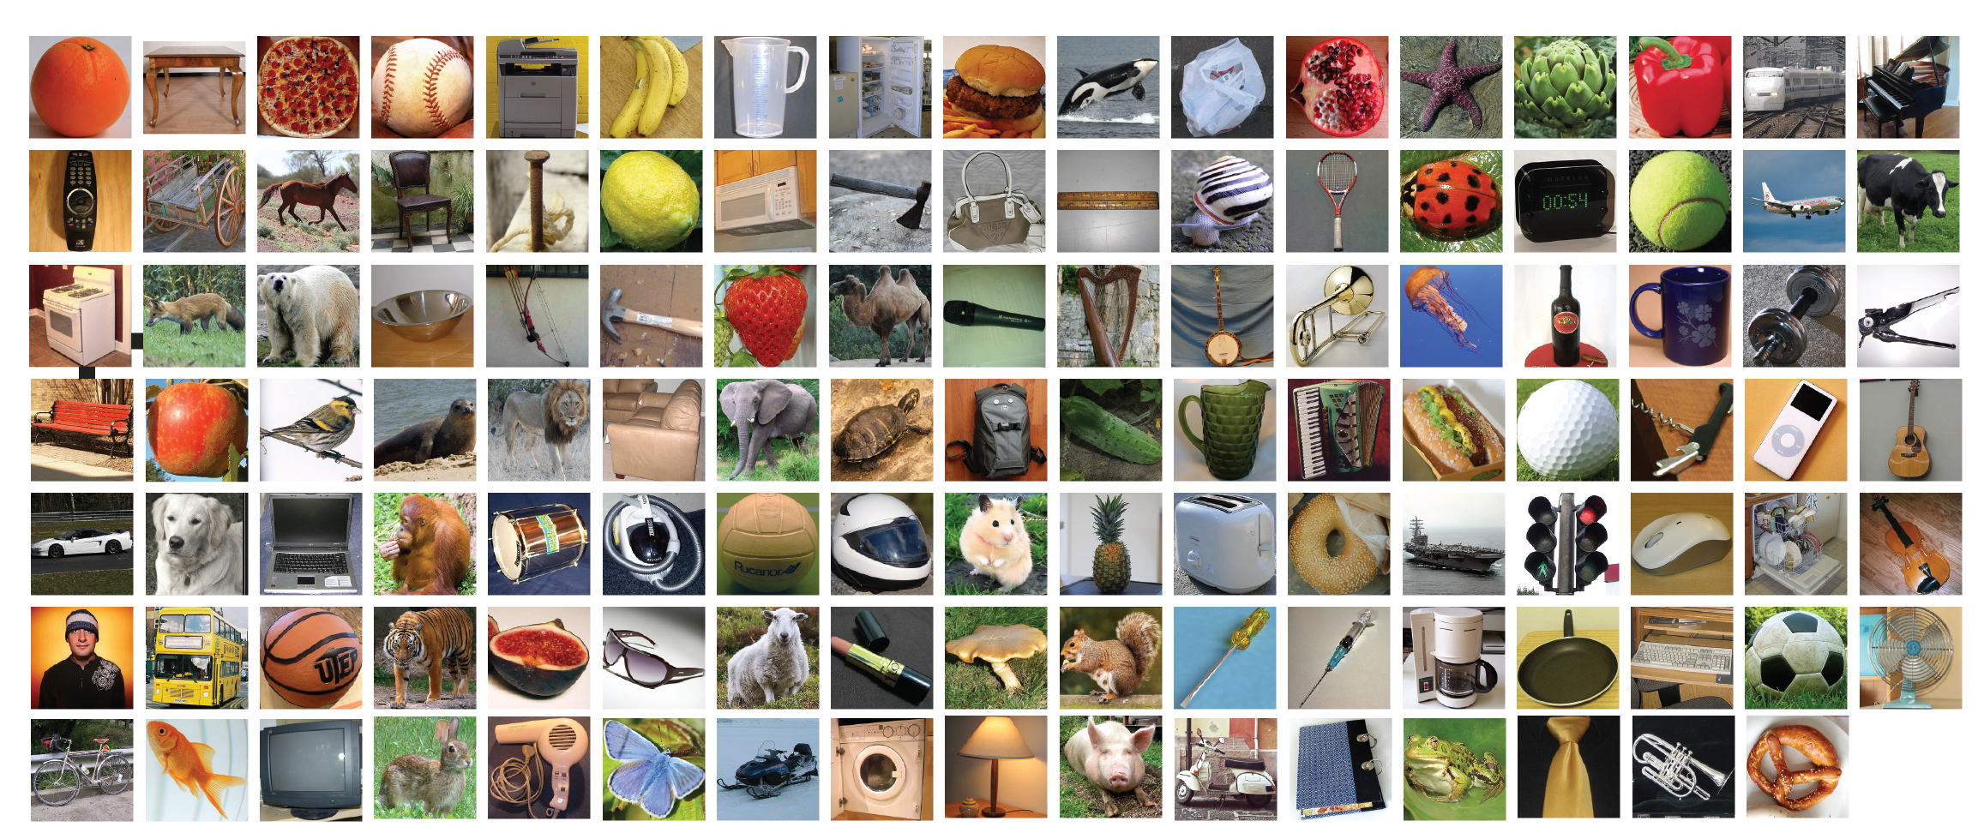
COMPUTER VISION TECHNOLOY CAN BETTER OUR LIVES

Slide 17
BIBLIOGRAPHY
https://github.com/jcjohnson/densecap
https://visualgenome.org/api/v0/api_beginners_tutorial.html
http://cs.stanford.edu/people/karpathy/densecap/
https://www.youtube.com/?gl=IN

Slide 18
Thank you...

